Slide 1
Volunteer Guide Rotation App
https://simard57.synology.me/Aqua
By Don Simard, simard57@hotmail.com
Notes:
The Link for the App is listed here https://simard57.synology.me/Aqua and is also on the footer of each slide.
So, if you wish to play with it during the talk or follow along with the slides; have at it!

Slide 2
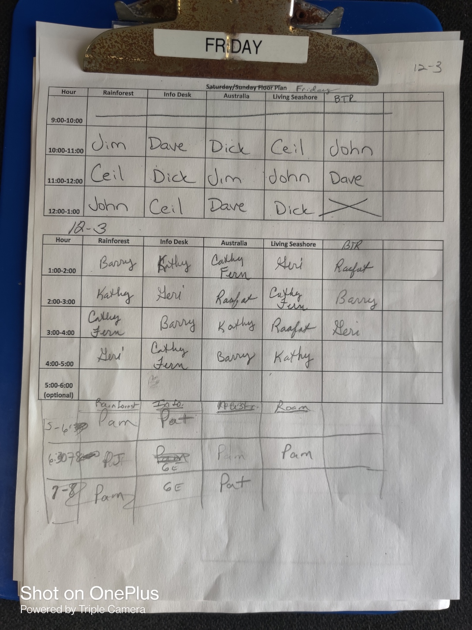
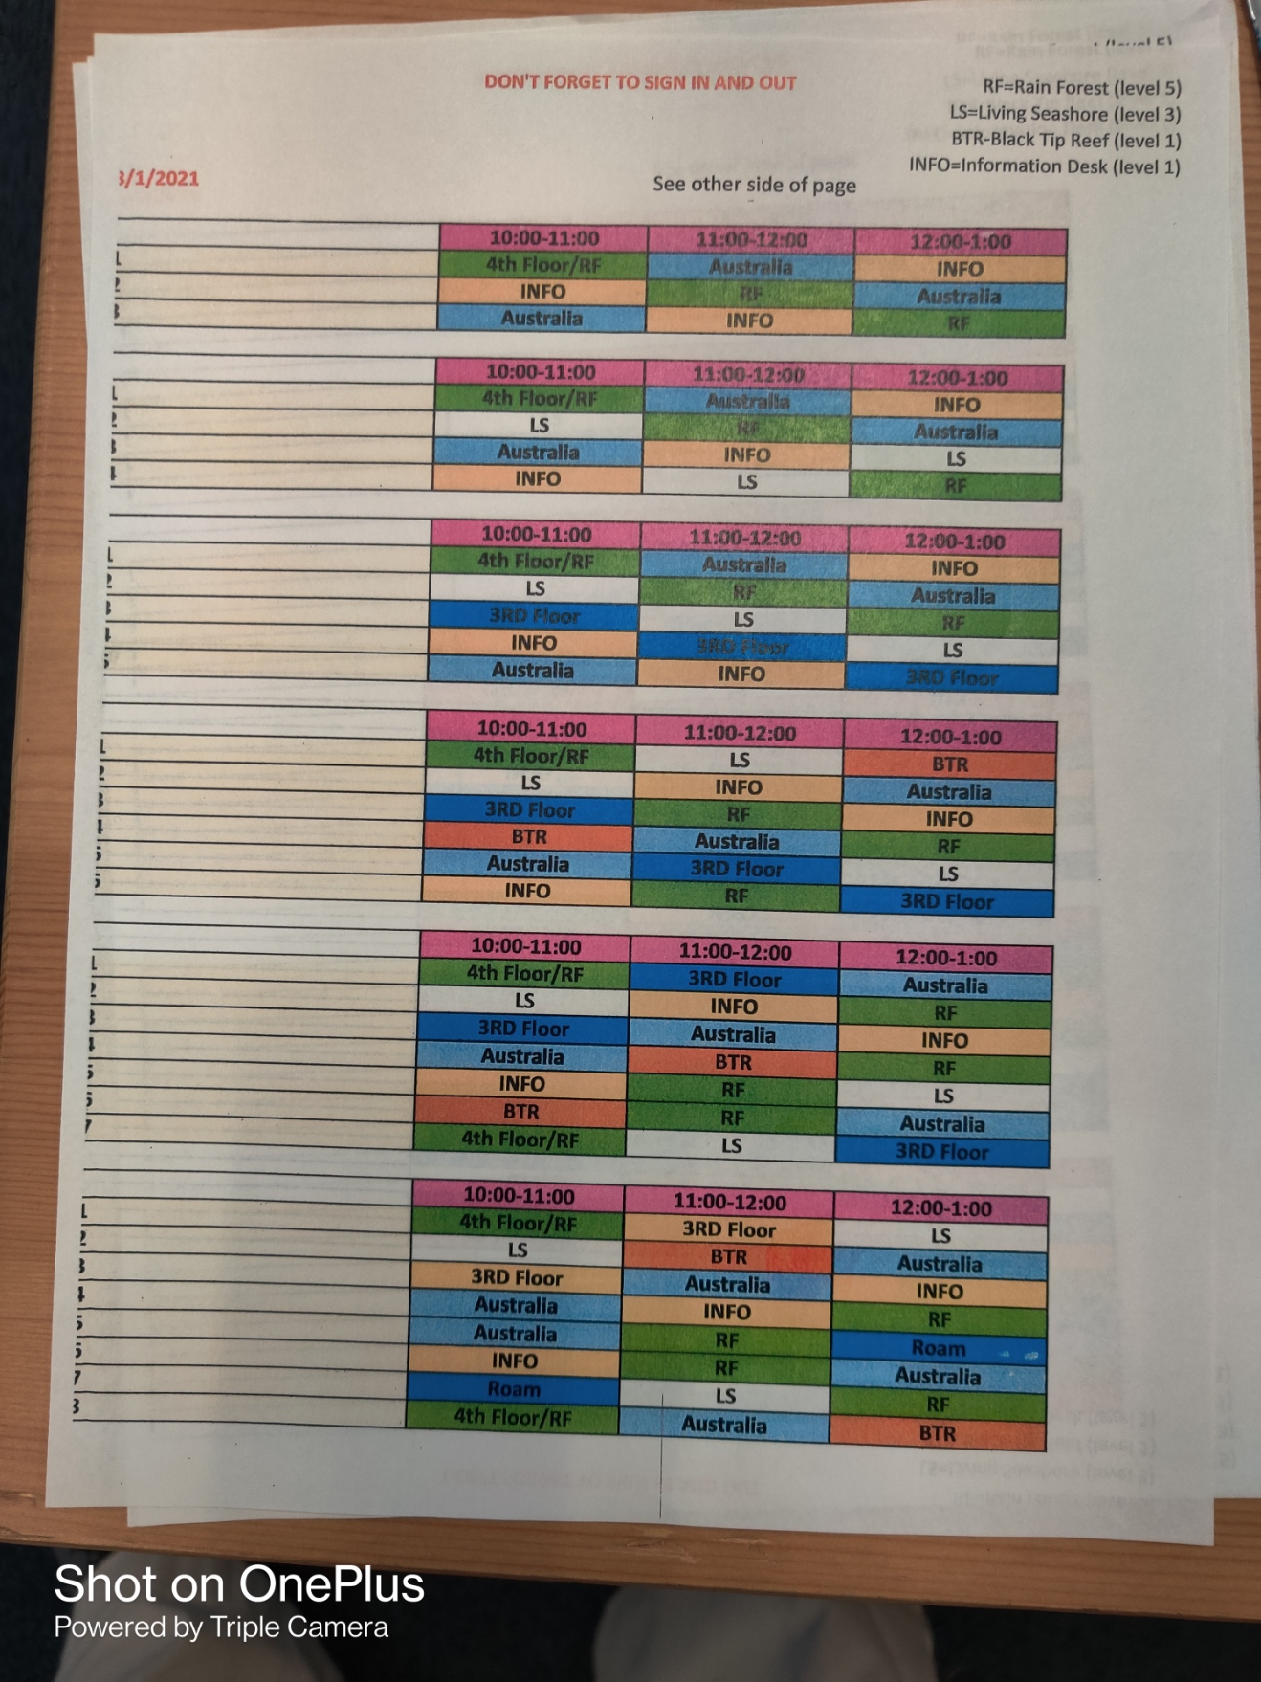
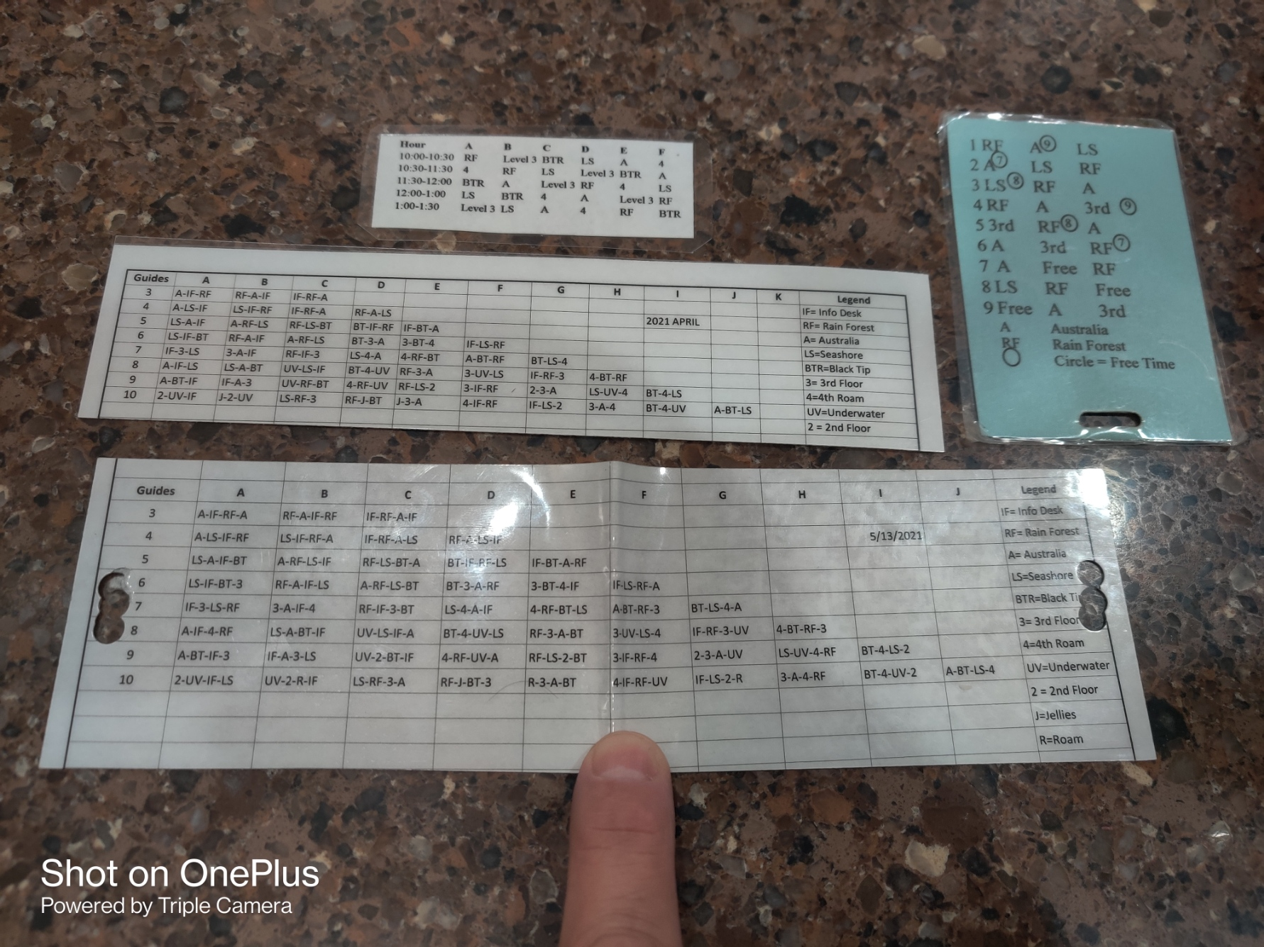
Rationale behind the App Why I did this App!
COVID project to brush up my web skills
Goal is to replicate all the paper aids being used
Improve customization of shift rotation
Make rotation more readable for mature eyes
Streamline the shift rotation assignments for guides
Yet another option to assign shift rotations
If what you are doing works, keep using it!
Notes:
I wanted to brush up on my programming skills. I learned how to use PHP in the sites HTML code.
As a test case, I decided to automate the Shift schedule we used for our Tuesday Morning shift.
After returning from COVID, we went through multiple iterations of the shift rotation, and it got confusing which one we were to use.
It also seemed a good way to reduce paper and plastic waste if only by a little – but every bit counts!
Obviously, Use what works best for your team. This is just another option.

Slide 3
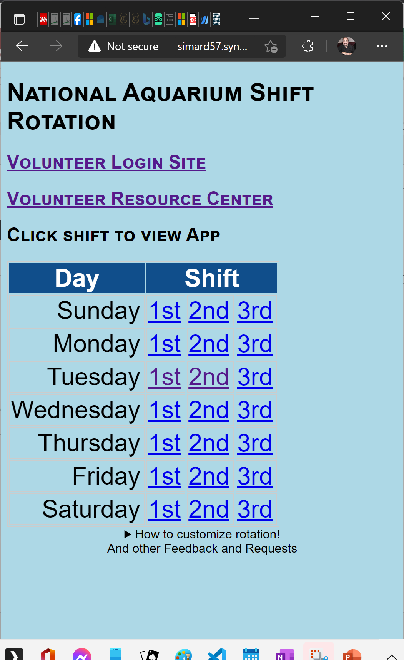
App Home Page
Website at https://simard57.synology.me/Aqua
Has links to Aquarium sites
The Volunteer login page
Volunteer Resource Center
To use
Select the day and shift you work
Allows shift rotation customization.
More on this later.
Notes:
I added a couple of links I was using often.
The app is a launchpad for things that are related to being an aquarium volunteer.
You can log your hours using the “Volunteer Login Site” link
You can access the “Volunteer Resource Center” to see the General Admission sales and estimates for crowd size
Click the day and shift to get to the scheduling aid. I work the Tuesday 1st Shift

Slide 4
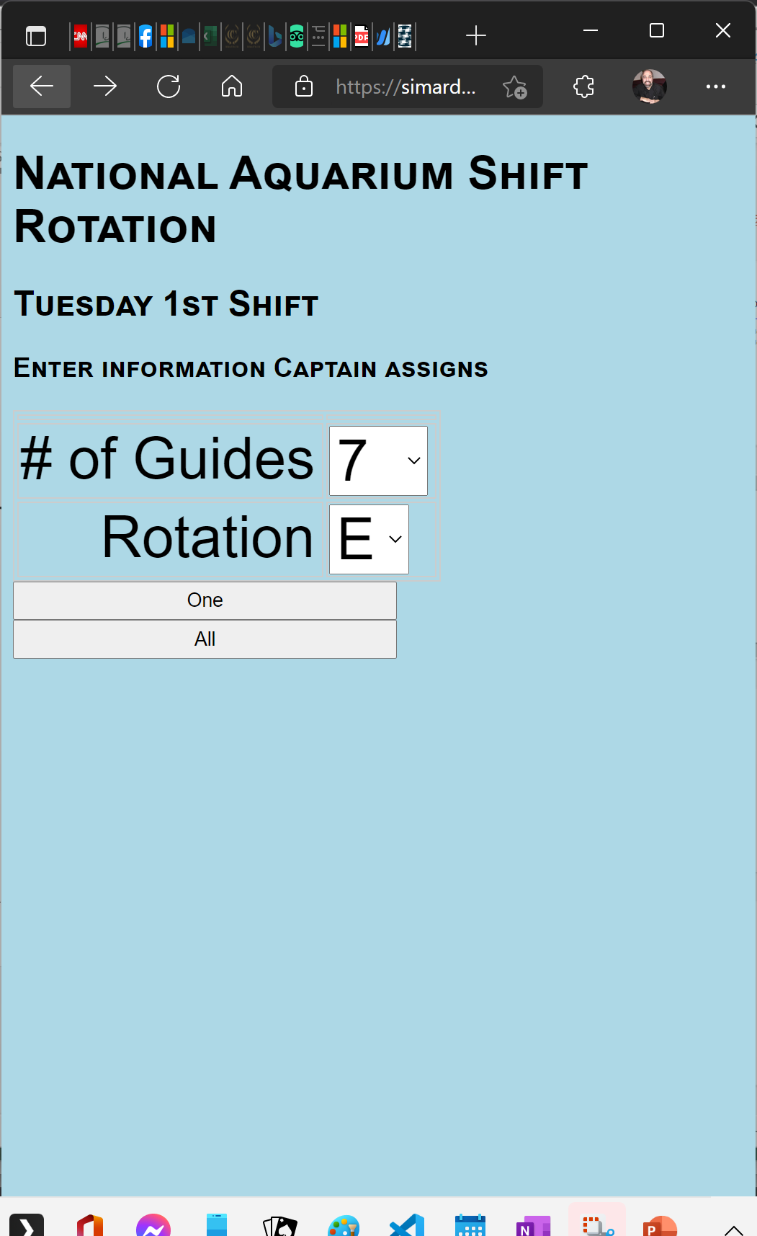
My Tuesday Morning Shift
Select the number of guides in the shift
Select the Rotation
Example here shows
7 Guides on shift
And I am assigned Rotation E
Click One or All
One shows only selected rotation
All shows selected rotation and all other rotations
Notes:
The Number of Volunteers varies each week so count the noses in the room and enter that for the number of Guides.
The Captain (or Guest Engagement) then assigns the rotation to each volunteer.
Click the One or All button (perhaps I should delete the One button to keep it simpler)

Slide 5
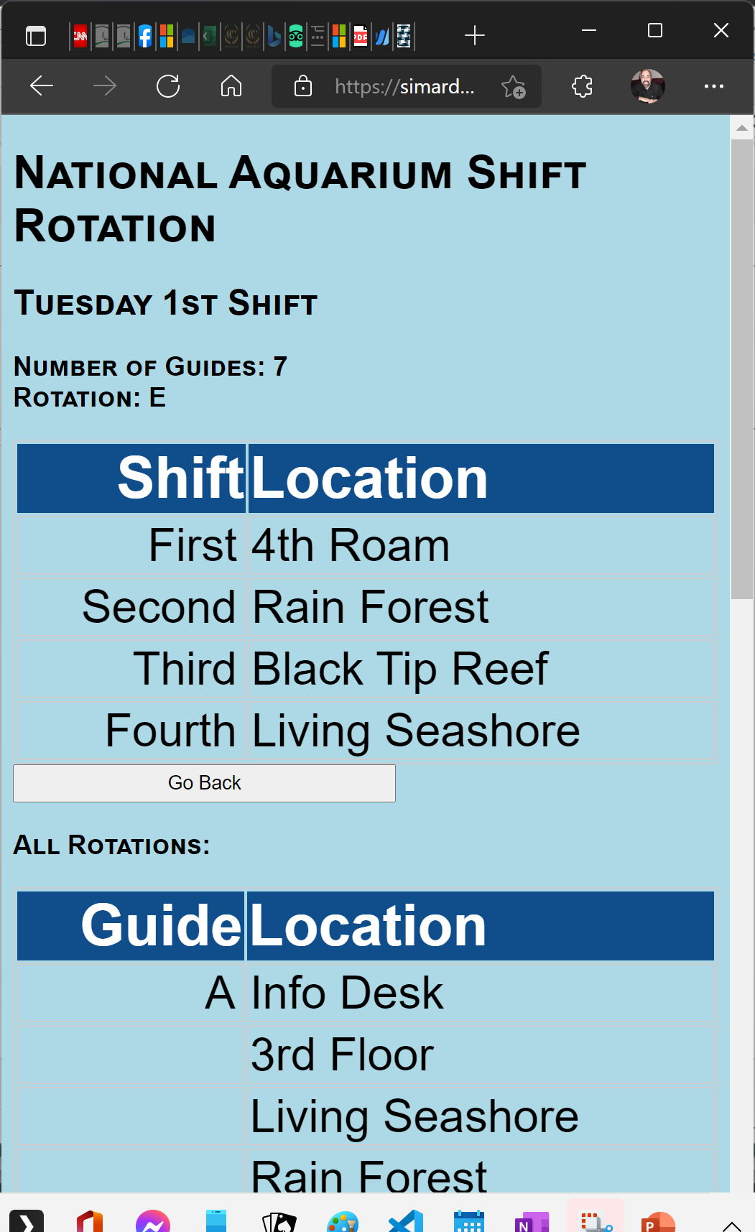
Rotation Summary
Rotation is listed in easy-to-read list
If One was clicked, single rotation is listed.
If All was clicked, each rotation can be seen by scrolling screen
Optionally take a screenshot of this screen to have easy access to rotation
Notes:
Which brings us to the Rotation Screen. The App displays a standard 4 shift rotation even though in offseason we only use the 1st three due to shorter hours.
If the All button was pushed, you will also see all the rotations that you can scroll through
I usually take a screenshot of this page to have access to it whenever I need to without having to go through the process all over

Slide 6
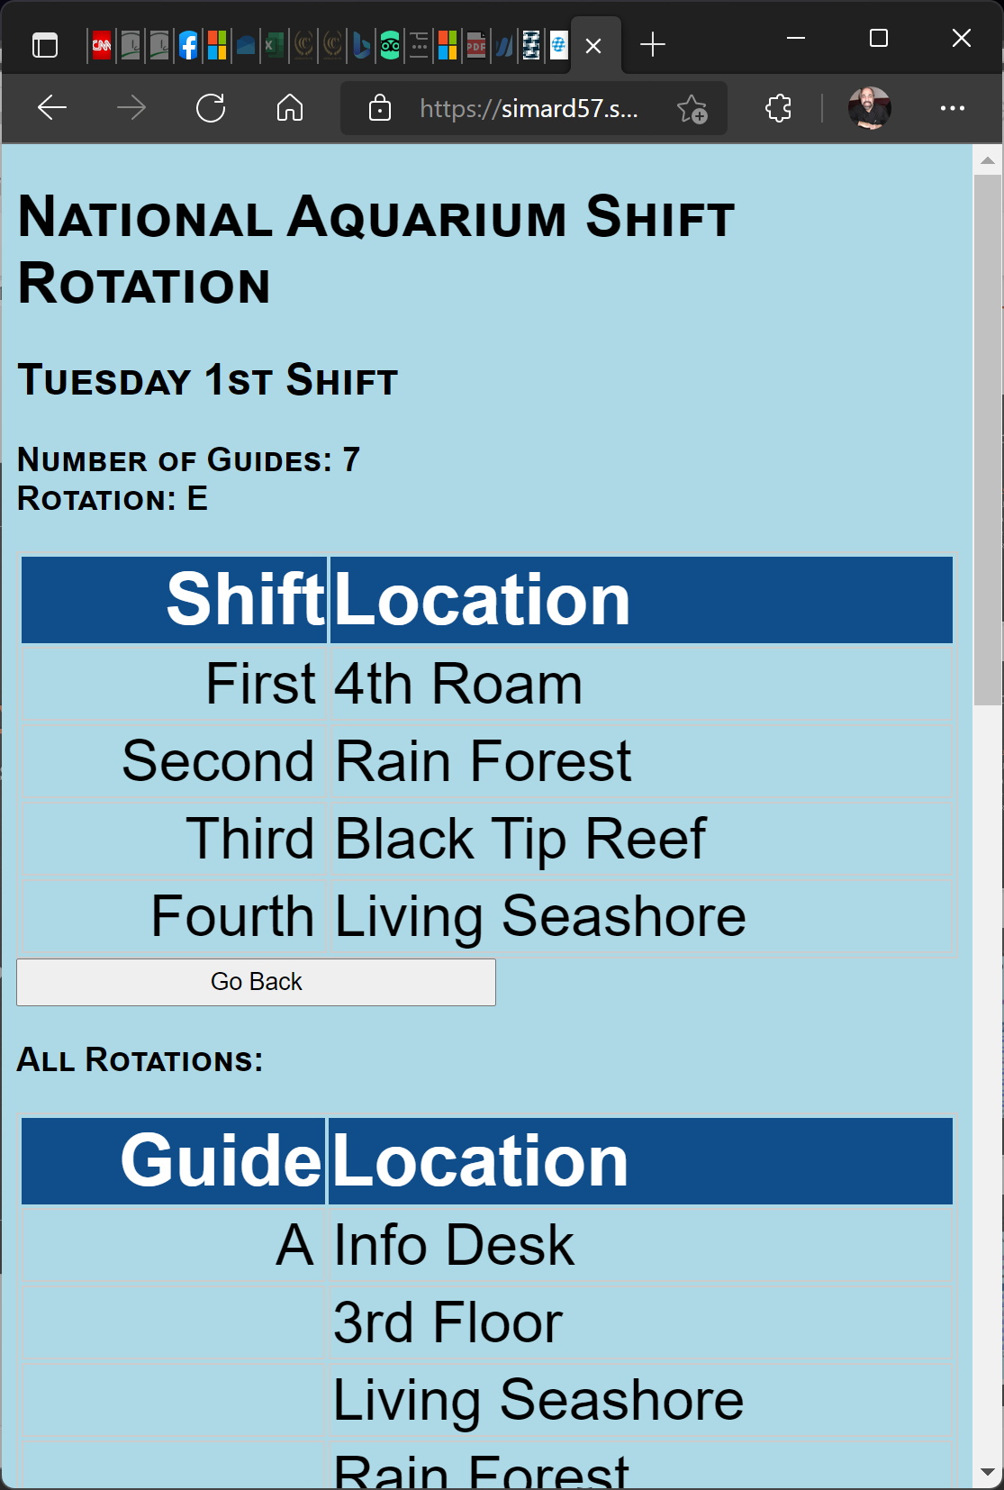
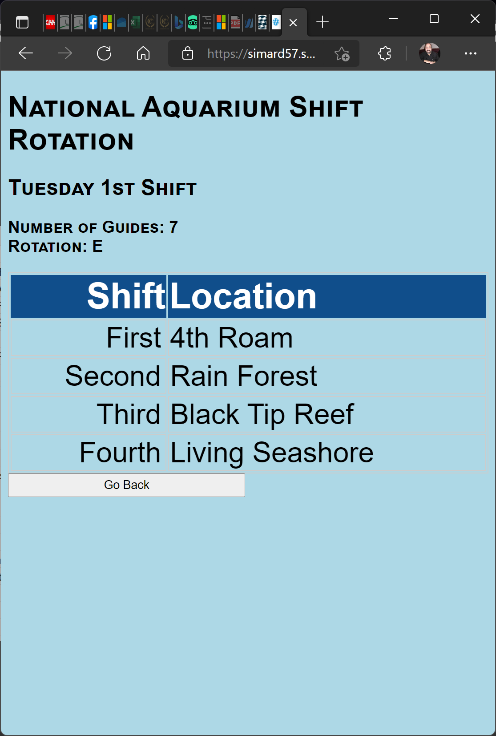
Rotation Summary
Rotation is listed in easy-to-read list
If One was clicked, single rotation is listed.
If All was clicked, each rotation can be seen by scrolling screen
Optionally take a screenshot of the screen to have easy access to rotation
Notes:
Which brings us to the Rotation Screen. The App displays a standard 4 shift rotation even though in offseason we only use the 1st three due to shorter hours.
If the All button was pushed, you will also see all the rotations that you can scroll through
I usually take a screenshot of this page to have access to it whenever I need to without having to go through the process all over

Slide 7
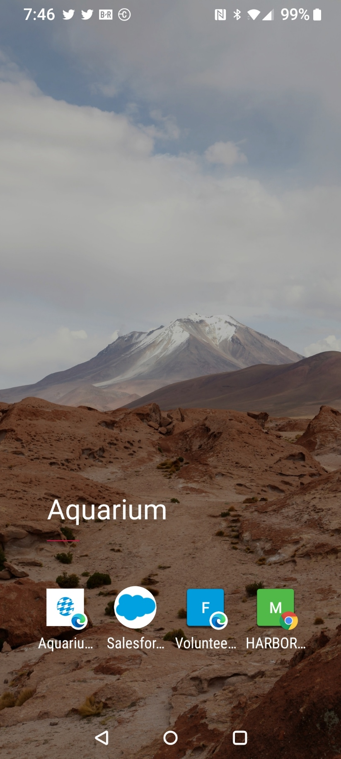
Save Site to Home Screen!
It is a good idea to save the Volunteer Guide Rotation website to phone home screen
Or at least save as a favorite
How to save to home screen is phone and browser dependent
Use Google or YouTube or ask your Grandkids to find instructions for your phone and browser
https://natomasunified.org/kb/add-website-to-mobile-device-home-screen/
Notes:
Putting a webpage on the phone’s home screen is dependent on the phone and browser you have. Link above has instructions for iPhone/Safari and Android/Chrome

Slide 8
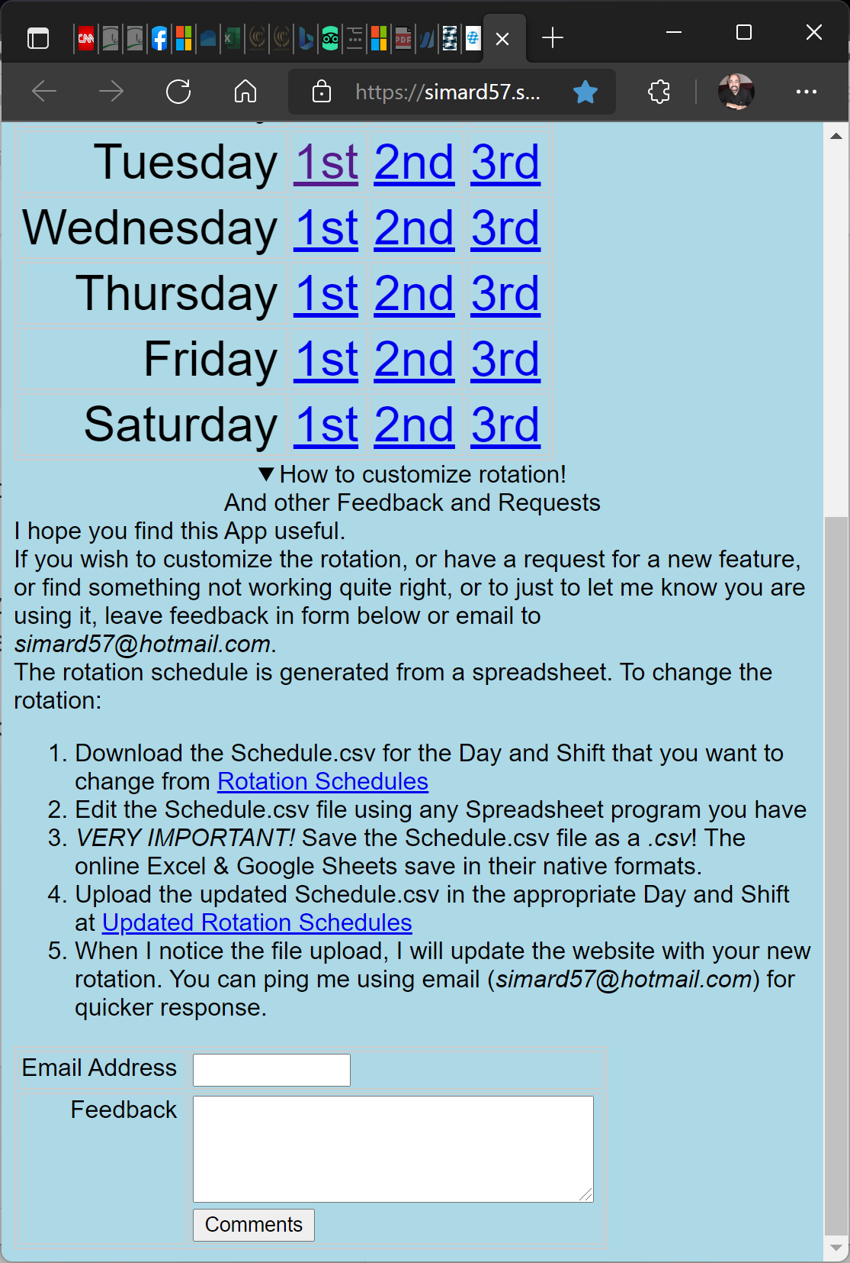
Customizing Shift Rotation
Instructions to customize displayed by clicking the triangle Glyph
Requires modifying simple spreadsheet
Notice the Feedback Form
Use to alert me a new schedule has been uploaded
Use to report bugs in the Scheduling App
Or just to let me know you are using the App
Use to request new features or report bugs you discover
Notes:
Each shift can create their own rotation. Captains tend to know what works best. How to customize the rotation is covered on the APP home screen. Click the Glyphe at the bottom to review instructions

Slide 9
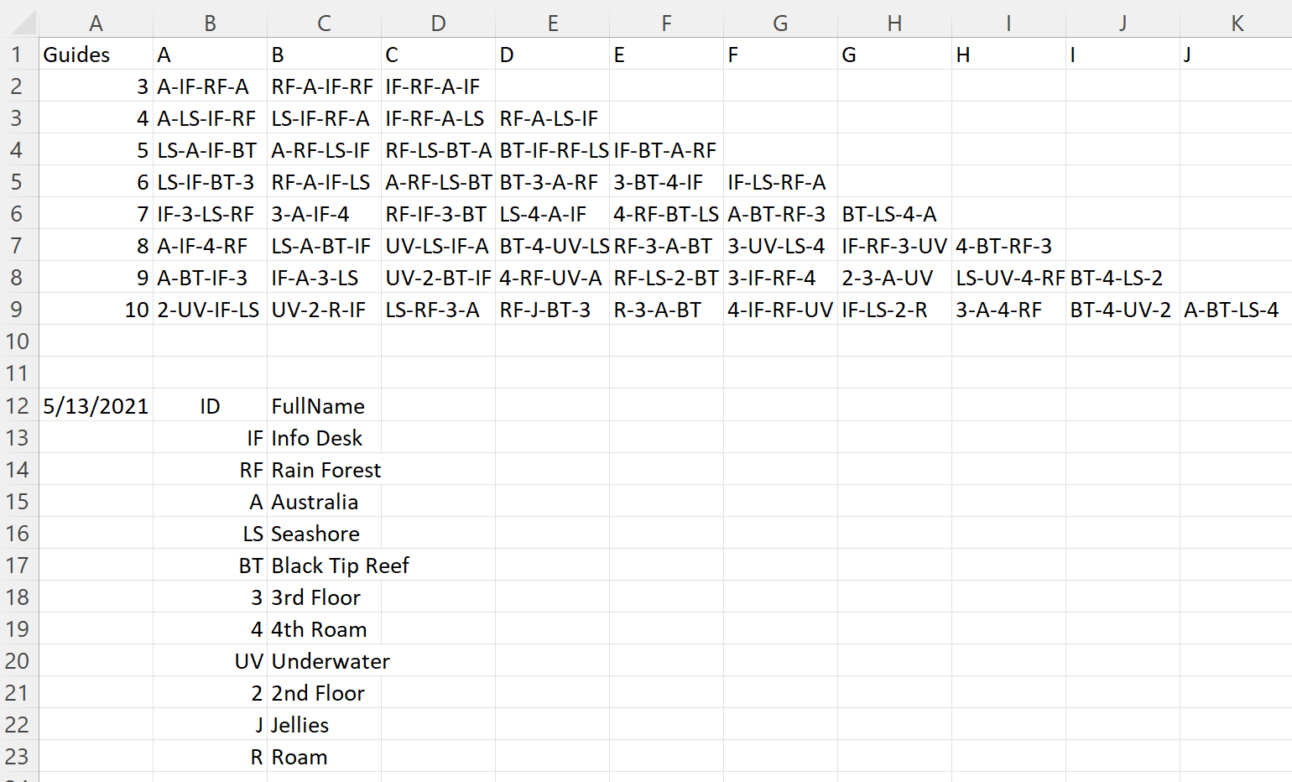
Behind the Scenes – The Rotation File
The rotations are read from a Spreadsheet file
Each row represents the number of volunteers that are on the shift
The Columns are the Rotation Assignments
The Cells contain the rotation as Dash separated abbreviations
The file has to be saved as a CSV format
Easy Peasy to change the rotation
Notes:
There is a simple spreadsheet behind each shift rotation schedule. It can be edited and returned to replace the current one in use Additionally, thie spreadsheet can be printed fand laminated or volunteers that prefer paper. (I hope they have good eyes)ou

Slide 10
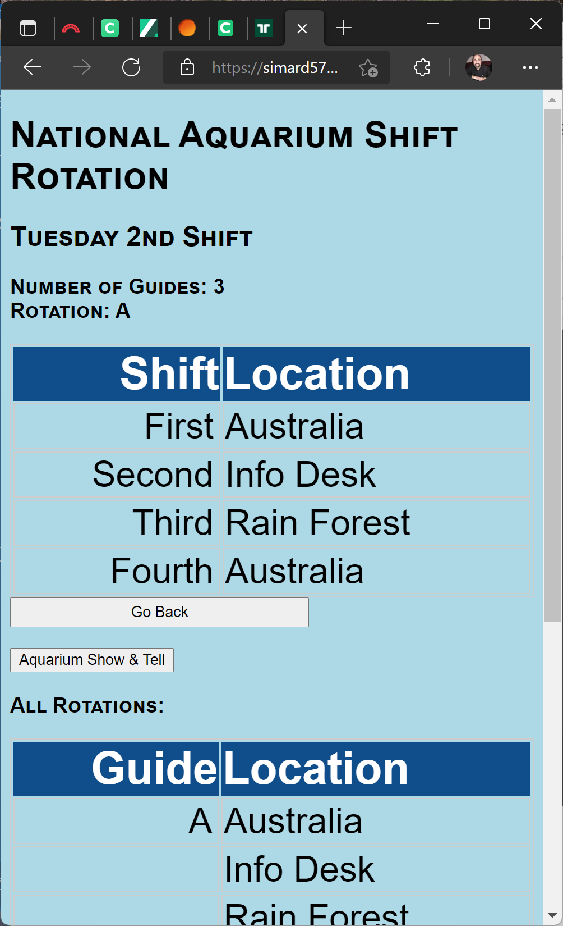
Recent Feature Added
Show & Tell links to Pictures and Videos of Aquarium animals
I use these during “quiet” hours to engage with guest to show them the Animals in ways not always seen.
The Sunbittern in all his glory (was he warning or flirting? I do not want to know!
Rarely seen Boat Billed Heron
The Sloth raiding a bird feeder
Archer fish in slow motion
Close-up of Screaming Piha
Currently it is a View-Only album but if you have pictures you would like to add, contact me
Notes:
A Bonus feature!
I try to take pictures of our animals when they are behaving in ways that guests may not be fortunate to see
The Sunbittern has hidden beauty
The Boat Billed Heron is a master of hiding
The sloths are more stationary and watching them close up is a rare treat
Though loud, sometimes the Piha is hard to find so showing people what to look for is a small pleasure

Slide 11
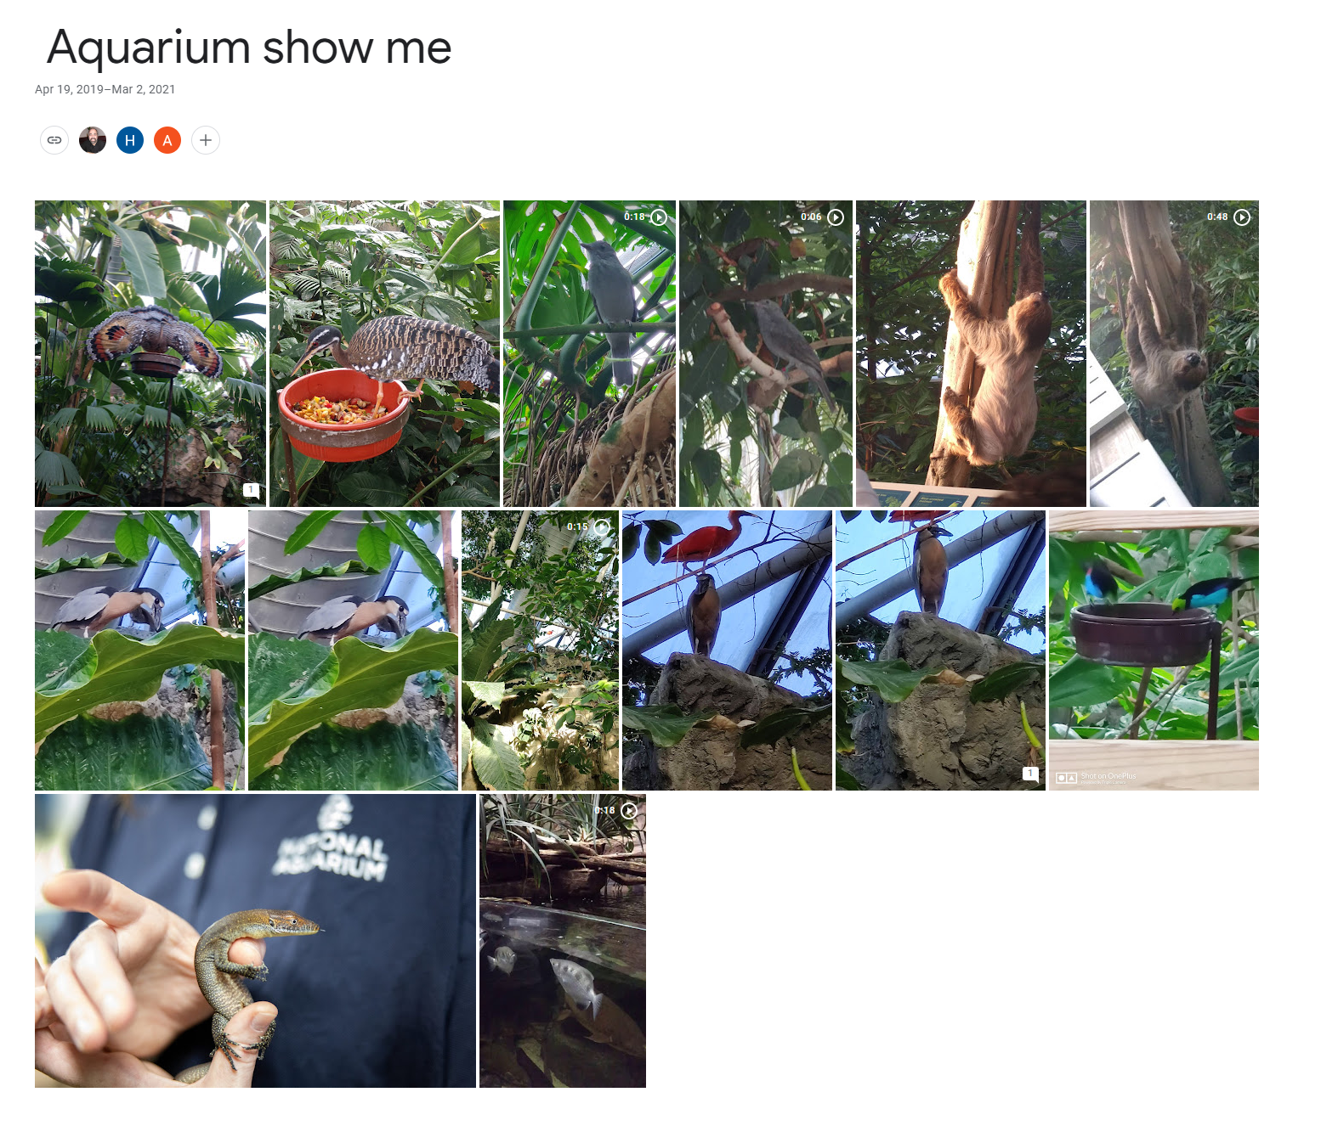
Shared Google Photo Album

Slide 12
That’s All Folks!
Hope you find it useful! https://simard57.synology.me/Aqua

